Slide 1

Open-Source Intelligence
(“OSINT”)
ssd.eff.org
Notes:
https://ssd.eff.org/en/playlist/activist-or-protester

Slide 2
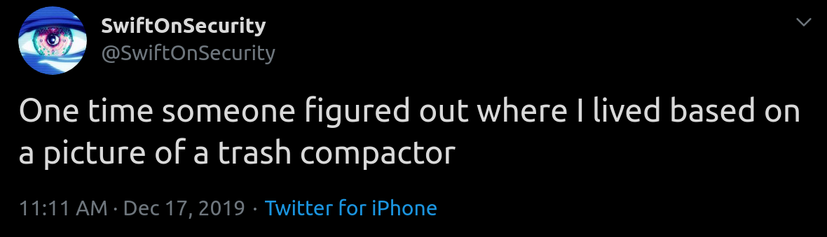
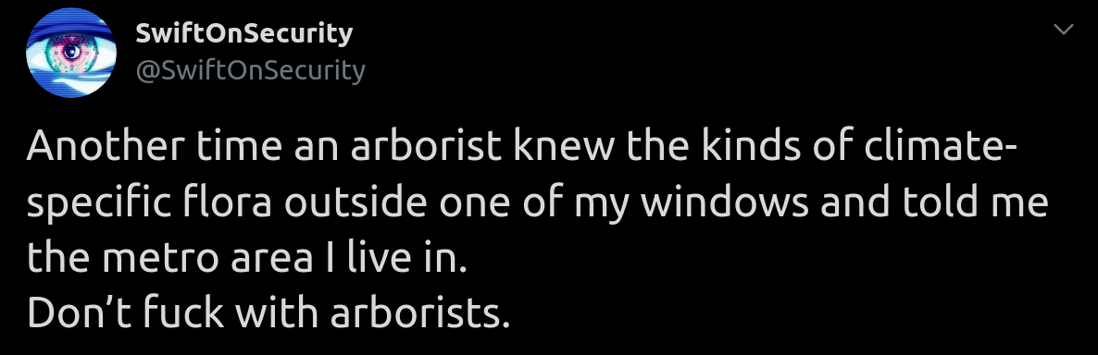
What’s OSINT?

Slide 3
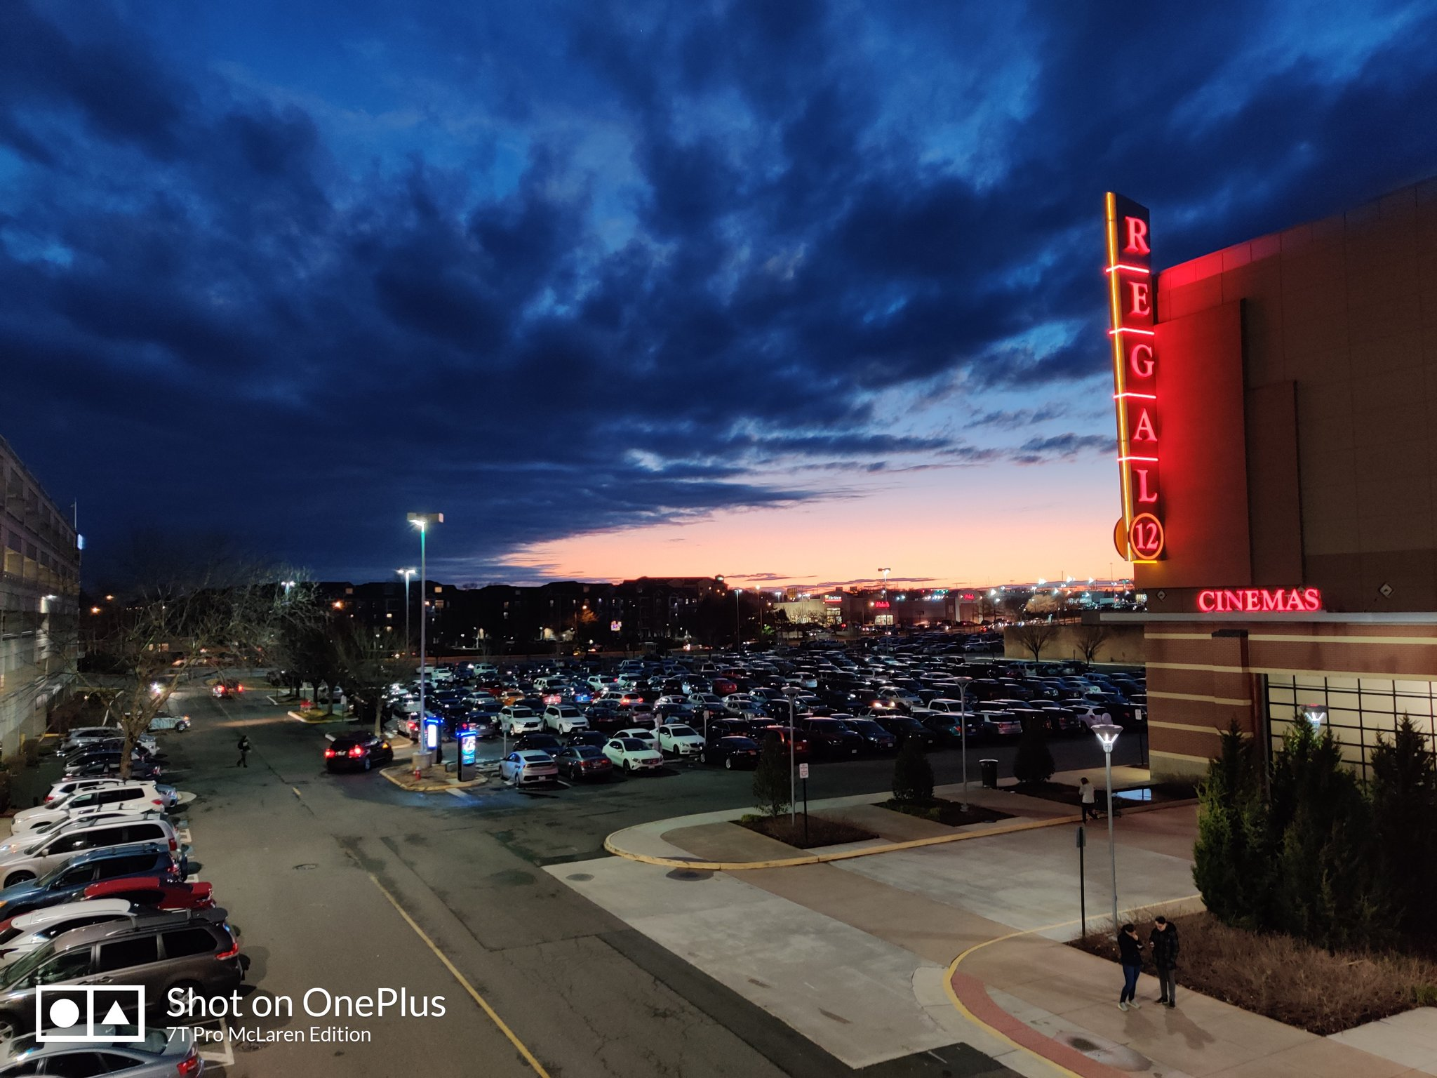
Q: Where was this photo taken?
(precise geographic coordinates)

Slide 4
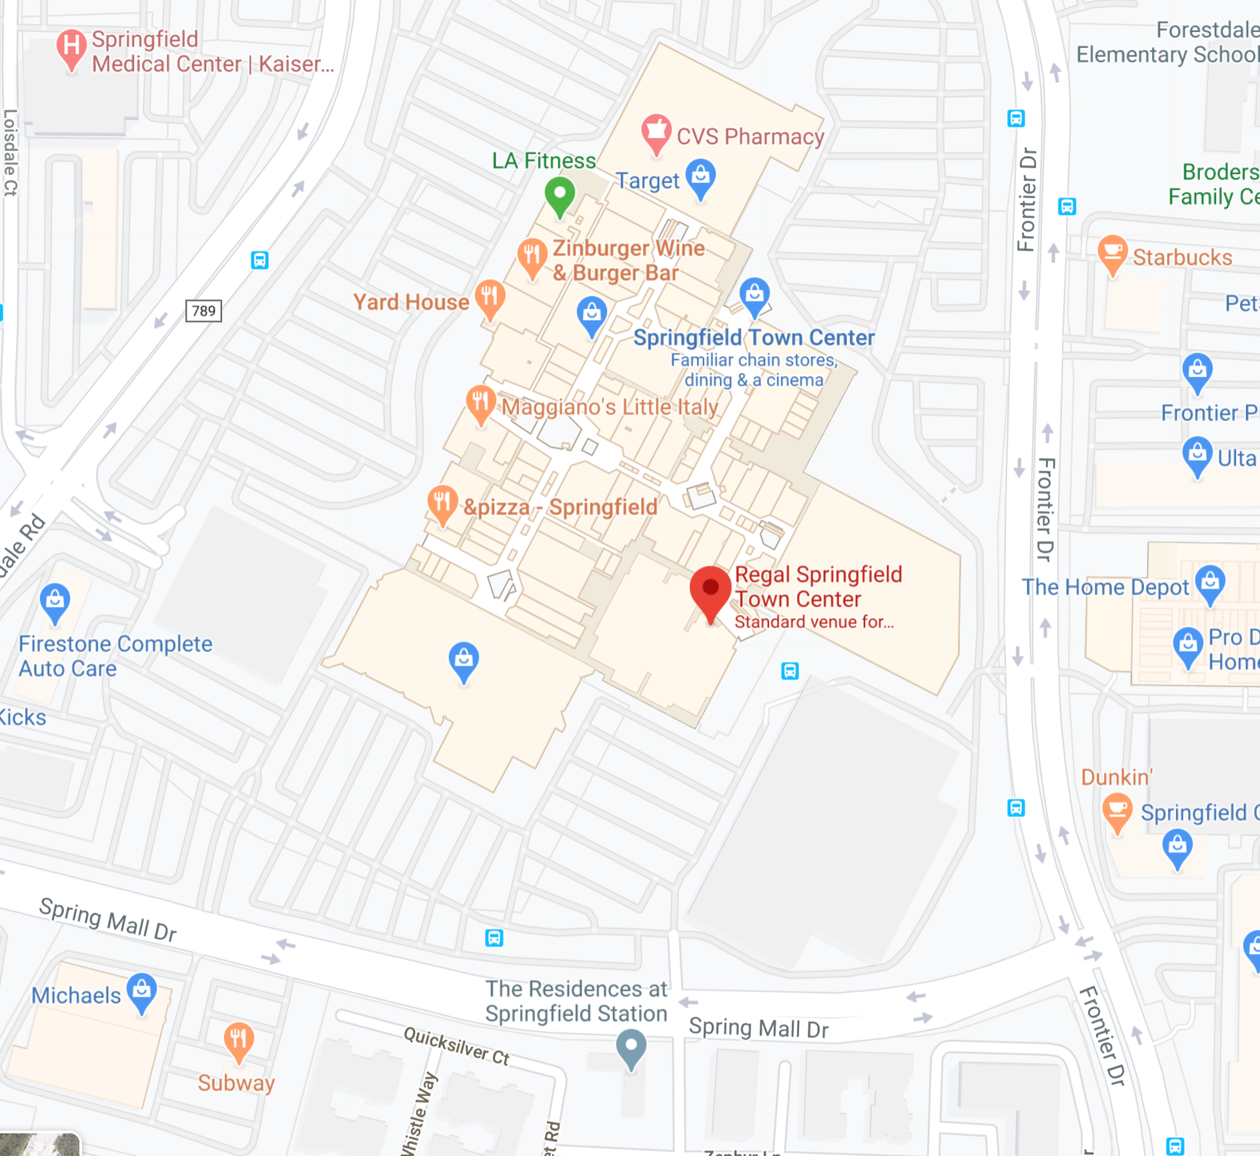
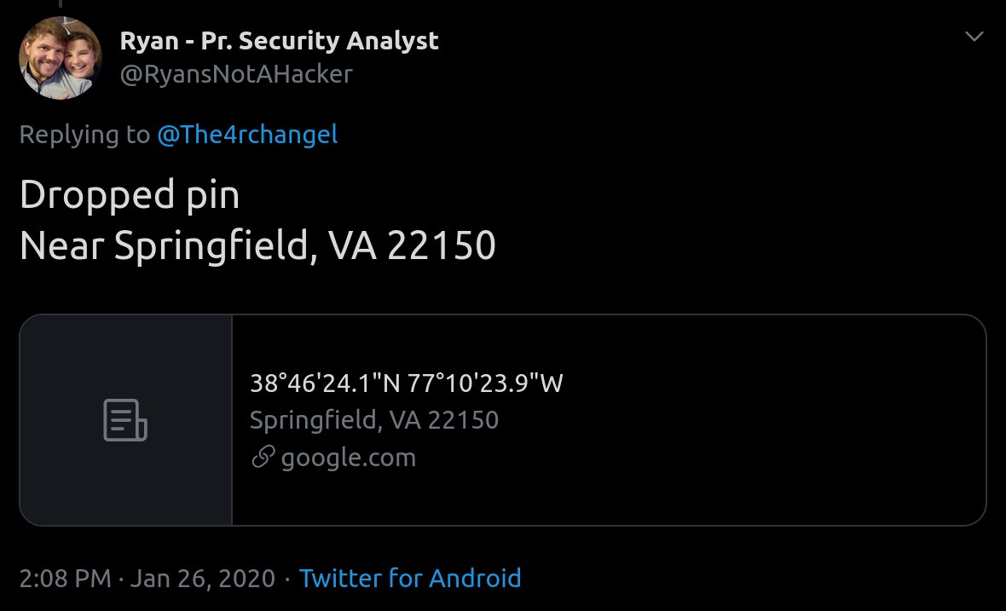
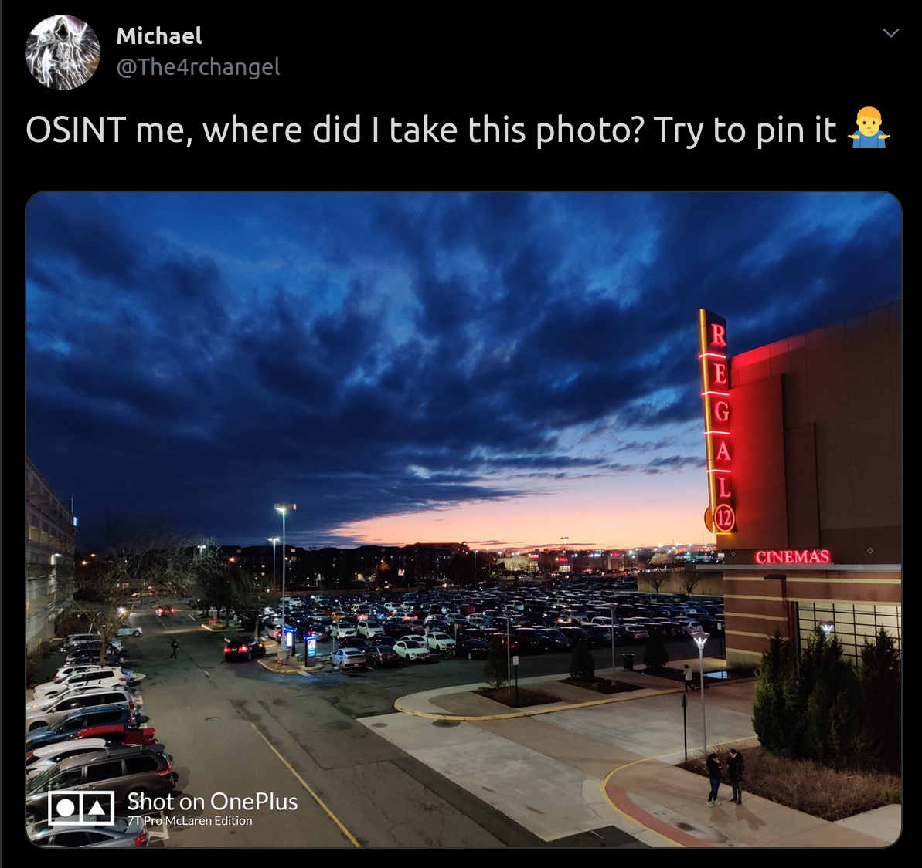

Slide 6


Slide 9


Slide 10


Slide 11


Slide 12
Nice cars (e.g. Teslas) == upper middle-class area
Well-kept trees, lots of signs, heavy traffic in street in the back, etc. == mall / shopping center
Garage structure on left
Angle of shot == probably taken from second floor

Slide 13
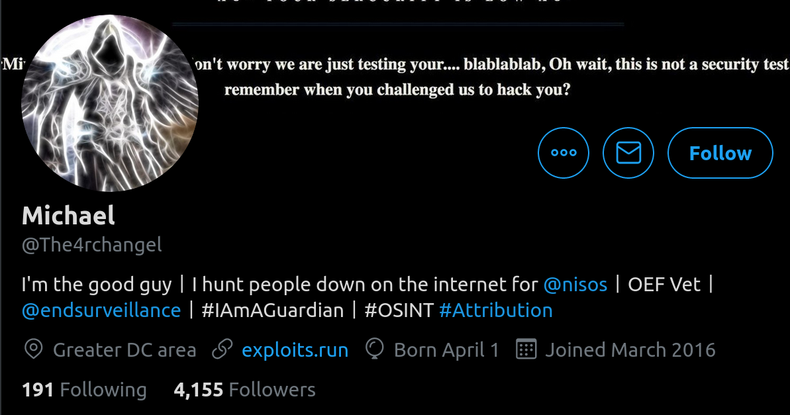

Slide 14
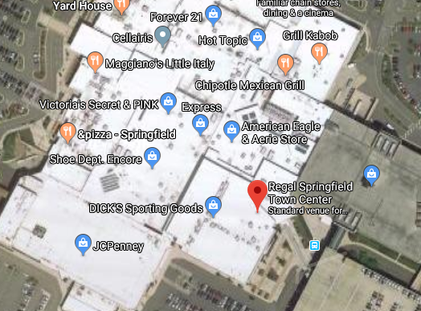
✔ Shopping center

Slide 15
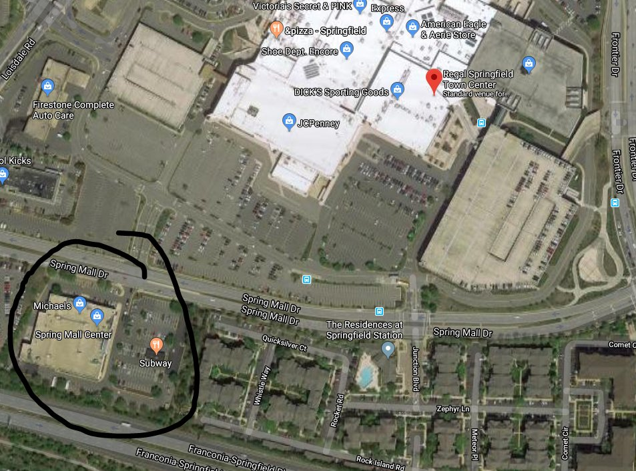
✔ Shopping center
✔ Michael’s/Tile Shop

Slide 16
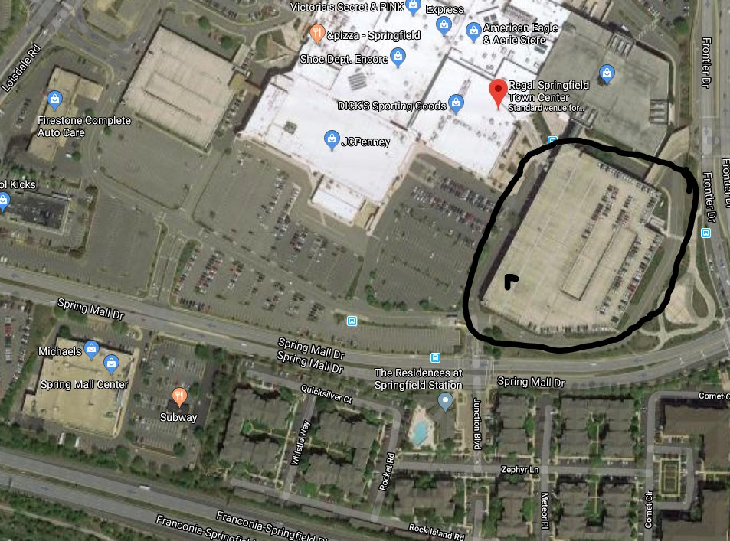
✔ Shopping center
✔ Michael’s/Tile Shop
✔ Garage next to cinema

Slide 17
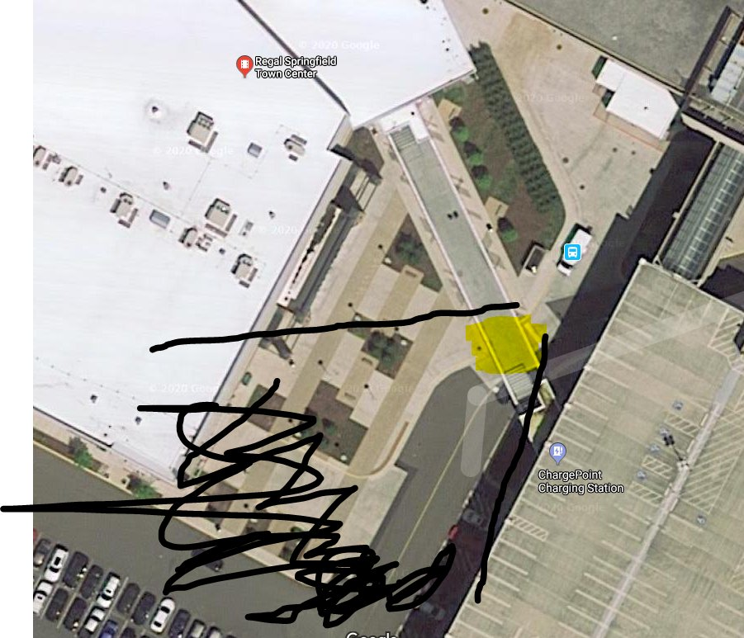
✔ Shopping center
✔ Michael’s/Tile Shop
✔ Garage next to cinema
✔ Walkway (2nd-floor view)

Slide 18
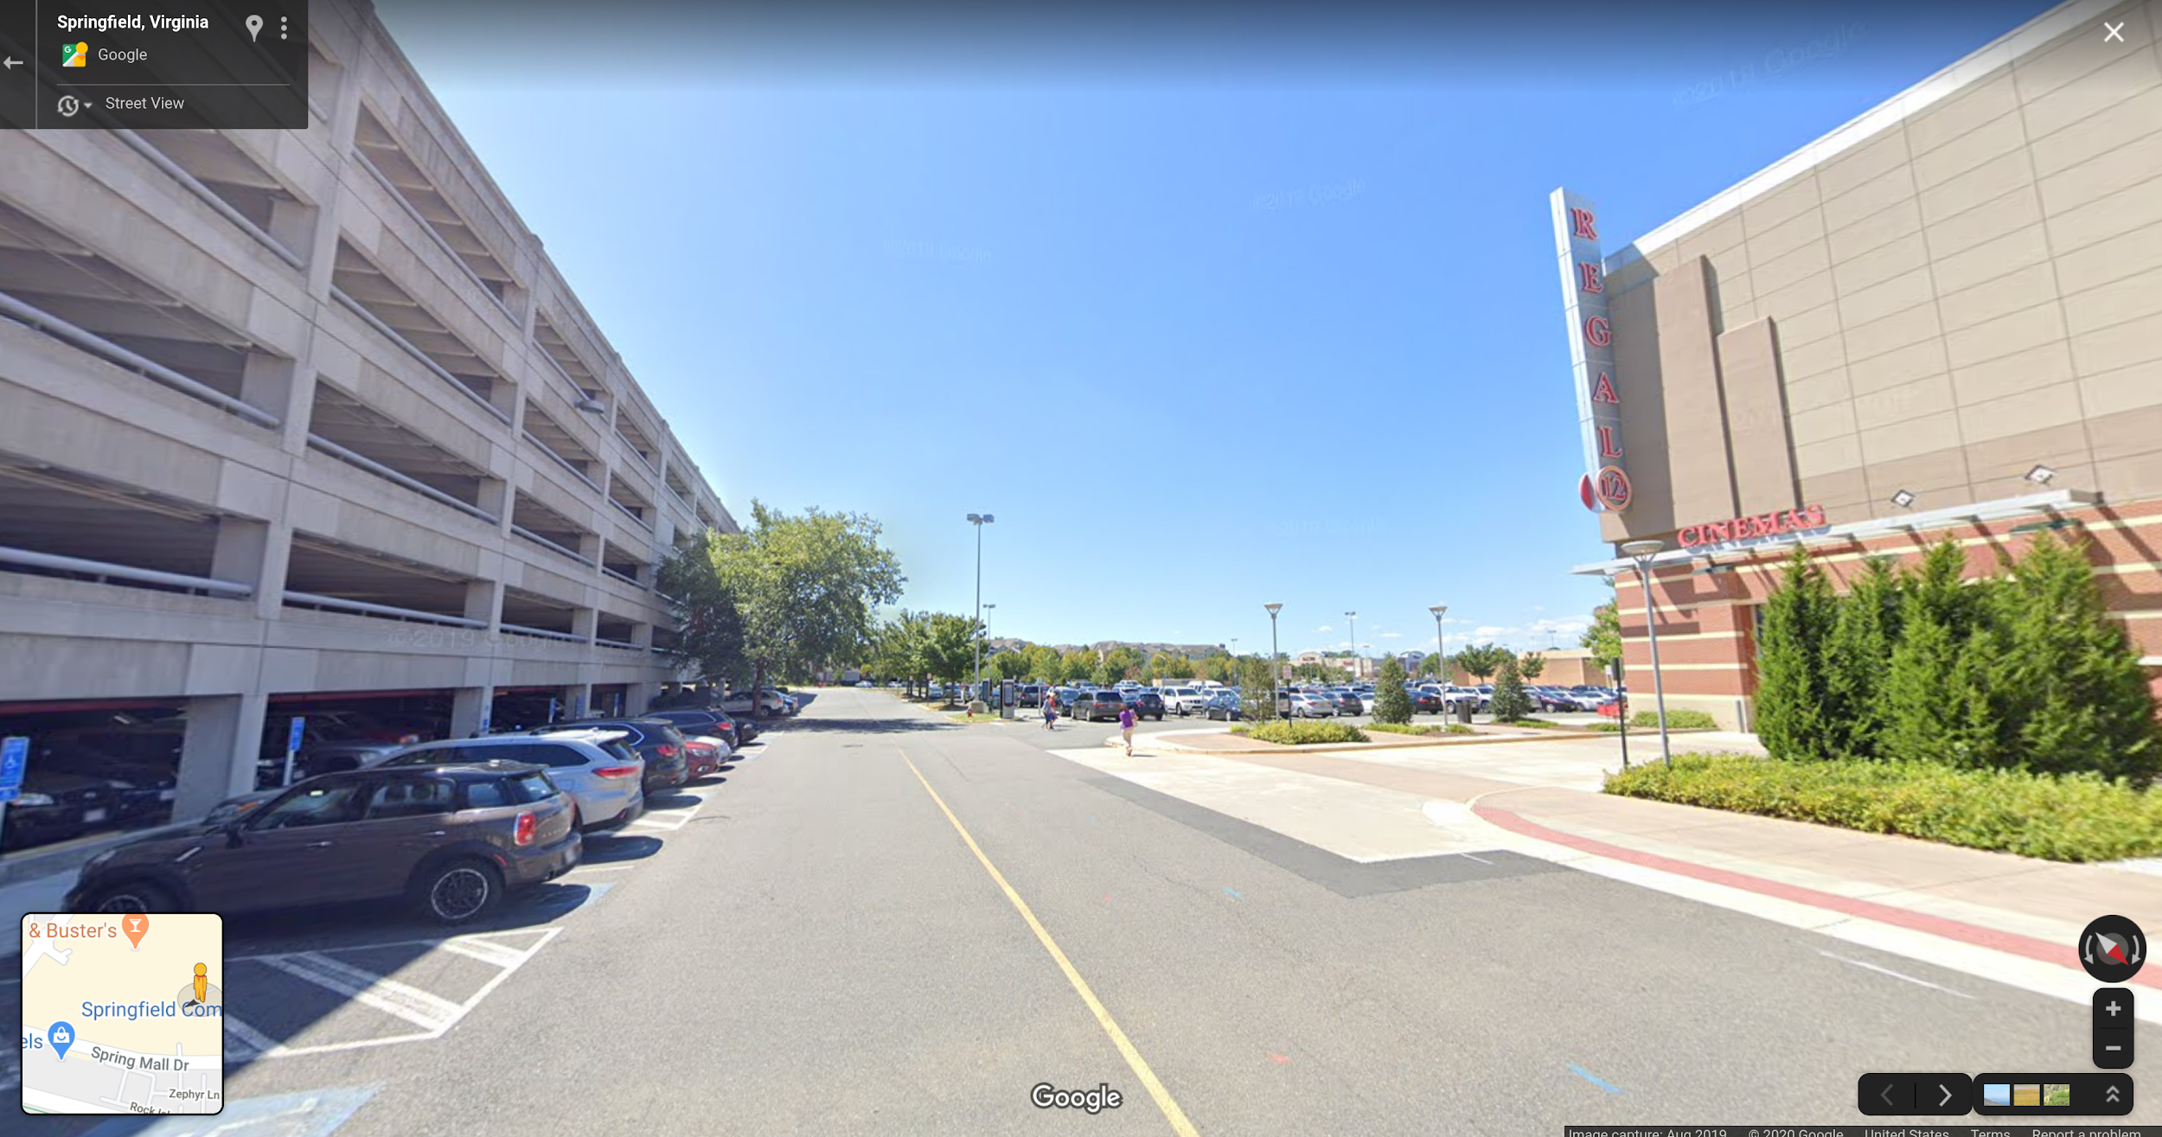
Google Maps

Slide 19
OSINT CTF
https://kernelmethod.github.io/osint

Slide 20
Protecting yourself from OSINT
You probably don’t need to start living in a cave

Slide 21
Protecting yourself from OSINT
You probably don’t need to start living in a cave
Generic advice (“don’t post personal information online!!!1!11!!) isn’t very helpful

Slide 22
Protecting yourself from OSINT
You probably don’t need to start living in a cave
Generic advice (“don’t post personal information online!!!1!11!!) isn’t very helpful
Instead focus on knowing your threat model

Slide 23
Protecting yourself from OSINT
Suppose you wanted to protect apartment and possessions. You might ask yourself:

Slide 24
Protecting yourself from OSINT
Suppose you wanted to protect apartment and possessions. You might ask yourself:
What do I have that’s worth protecting?

Slide 25
Protecting yourself from OSINT
Suppose you wanted to protect apartment and possessions. You might ask yourself:
What do I have that’s worth protecting?
Who do I want to protect it from?

Slide 26
Protecting yourself from OSINT
Suppose you wanted to protect apartment and possessions. You might ask yourself:
What do I have that’s worth protecting?
Who do I want to protect it from?
How likely is it that I will need to protect it?

Slide 27
Protecting yourself from OSINT
Suppose you wanted to protect apartment and possessions. You might ask yourself:
What do I have that’s worth protecting?
Who do I want to protect it from?
How likely is it that I will need to protect it?
How bad are the consequences if I fail?

Slide 28
Protecting yourself from OSINT
Suppose you wanted to protect apartment and possessions. You might ask yourself:
What do I have that’s worth protecting?
Who do I want to protect it from?
How likely is it that I will need to protect it?
How bad are the consequences if I fail?
How much trouble am I willing to go through to prevent these consequences?

Slide 29
General OpSec tips
Be careful what name you use, including your username
Immediately go to your privacy settings
Be cautious about any picture you upload -- both the contents of the picture and metadata
Use two-factor authentication (2FA) and use a password manager
Notes:
Others:
Consider using a separate email address, and try to avoid giving your phone number

Slide 30
OpSec tips for the truly paranoid
(and those who actually need them)
Use end-to-end encrypted messaging
Use ad blockers
Use a VPN (not a catch-all tool)
Delete all social media and request data deletion if you can (GDPR, CCPA)

Slide 31
Closing remarks
Be realistic about the threats you face
“Security is a process, not a purchase”
Check out resources on the last slide

Slide 32
Resources
OSINT Framework: https://osintframework.com
Ryan Clark (Twitter: @RyansNotAHacker)
Surveillance Self-Defense (Electronic Frontiers Foundation): https://ssd.eff.org/

